Slide 1

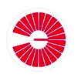

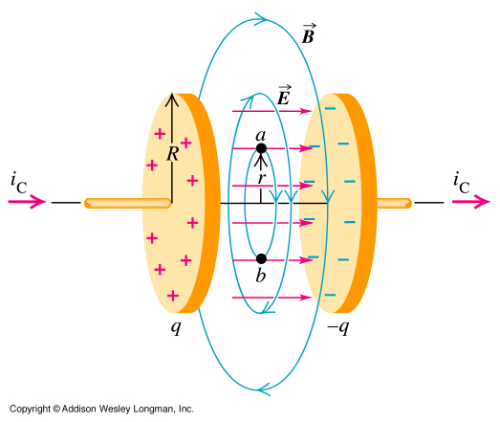
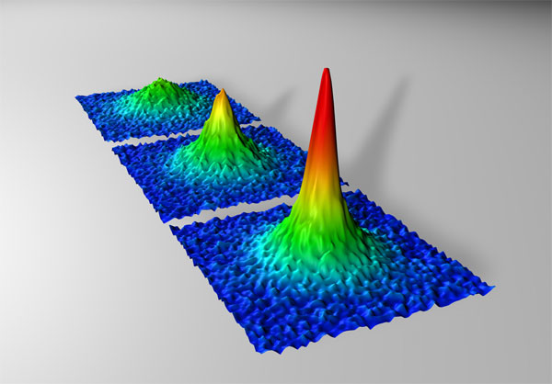
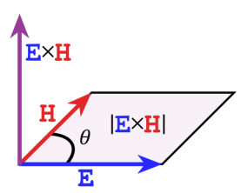
M. Ja. Ivanov, Yu. I. Malakhov, G. F. Saveliev, Zheng Guanghua
A single electro dynamical force field with gradients of electrical potential and gas dynamic pressure for all known interactions in condensed and non-condensed matter with examples of exact and numerical solutions
Displacement current and potential
Potential distributions for Fermi condensate
CIAM, Moscow,10 June 2021

Slide 2
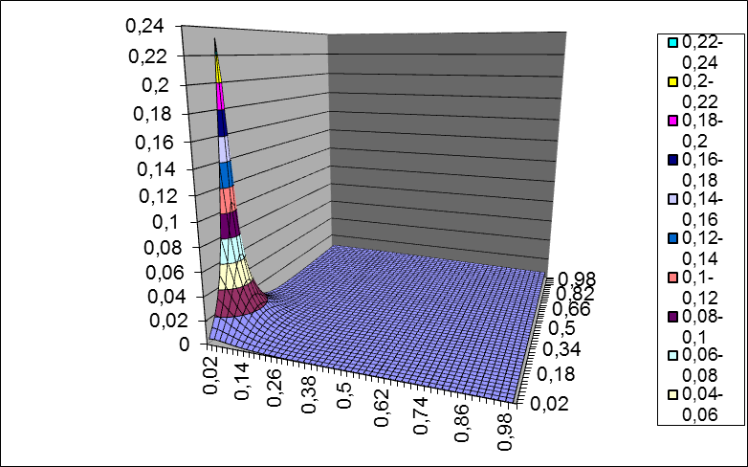
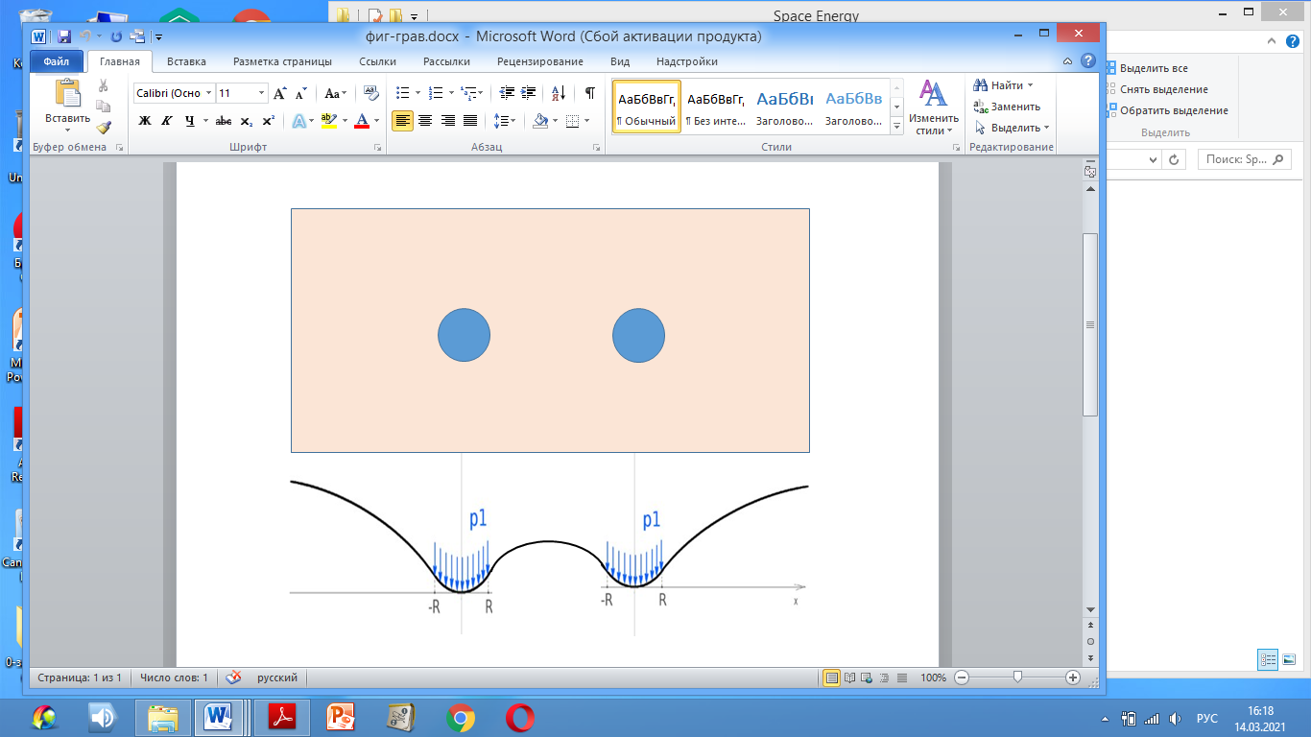
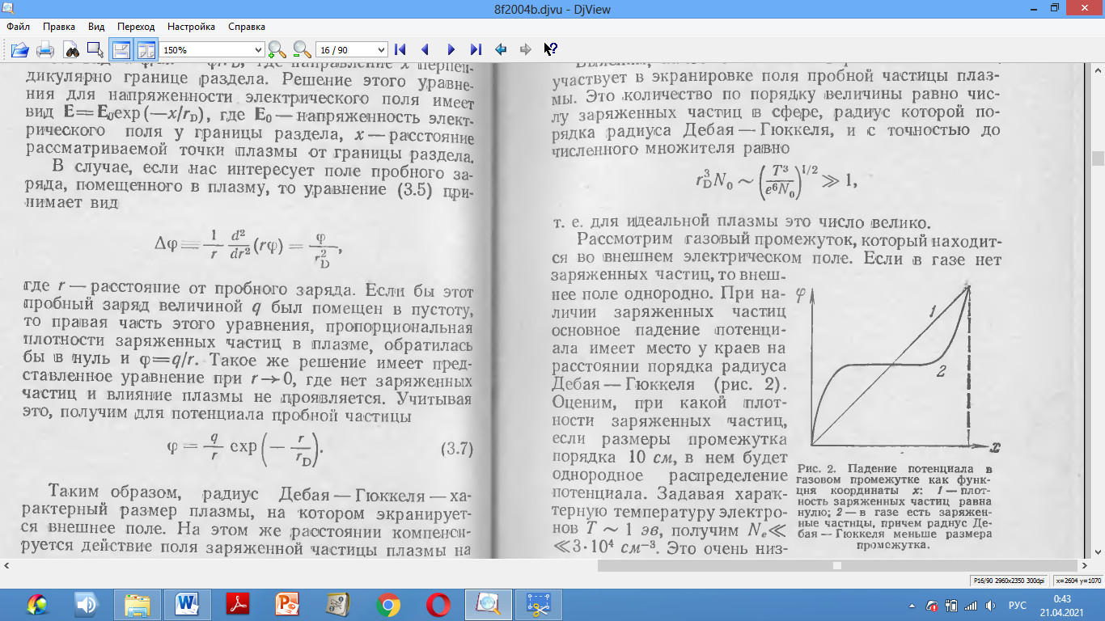
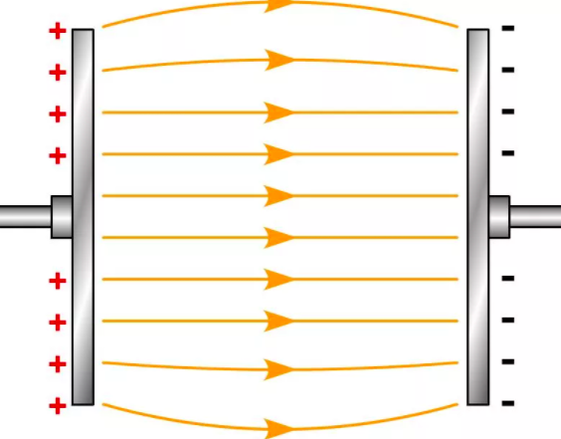

Single force field with gradients of electrical potential and gas dynamic pressure
Polarized space of the hydrogen atom and potential distribution
in the two dimensional model problem of gravity for two bodies
Stationary
equilibrium
D =sqrt (ε₀· kT₀/ne²)
+
+
+
+
E = mc² = hν = kT
Temperature
T₀=2.735 K
State equation
p = n∙mc² = n∙kT
Hidden mass boson
(classic dipole)
kg ≈ 3∙10⁻⁴ eV
q = 5∙10⁻²⁹ C
D
+
+
+
+
Coulomb’s law
Newton’s law
Potential distributions
without and with screening
transfer Coulomb’s law to
Newton’s law

Slide 3
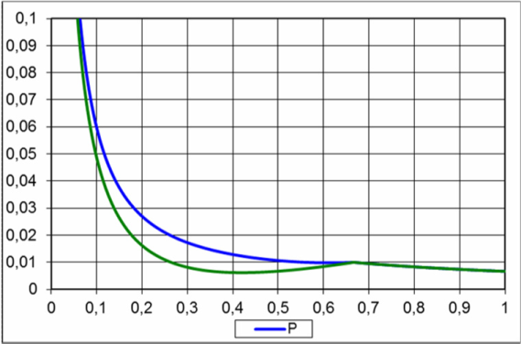
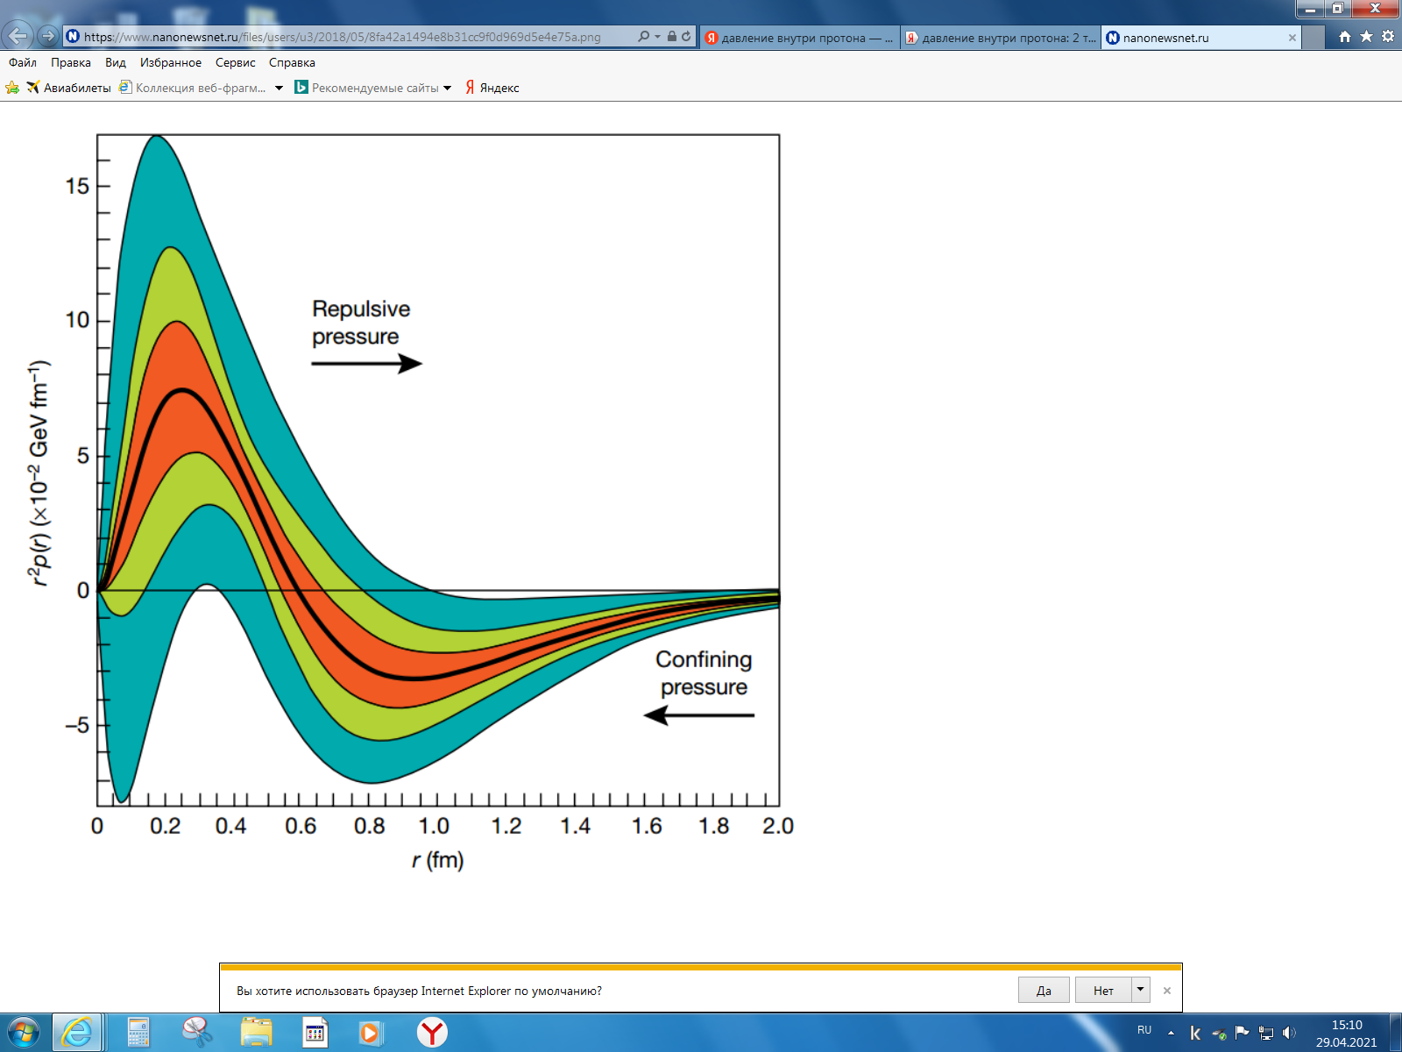
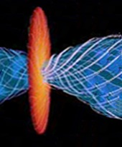
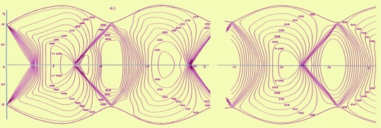
Unified theory (UT) of electromagnetics, electroweak, strong and gravitation
electromagnetics
electroweak
strong
Burkert, V.D., Elouadrhiri, L. & Girod, F.X. The pressure distribution inside the proton. Nature 557, 396–399 (2018).
The pressure inside the proton has been measured and it equals 10³⁵ Pa. Our state equation as p ≈ nkT for DM particle concentration inside proton n_{p}=10⁵⁷1/m³ gives the same value 10³⁵ Pa. This is very good confirmation of our single electro dynamical force field simulation.
Internal structures of deuterium, tritium and helium 3He and 4He.
gravitation
Integral curves of exact solutions in the phase plane (v,p) and numerical simulation CJ of M87.

Slide 4
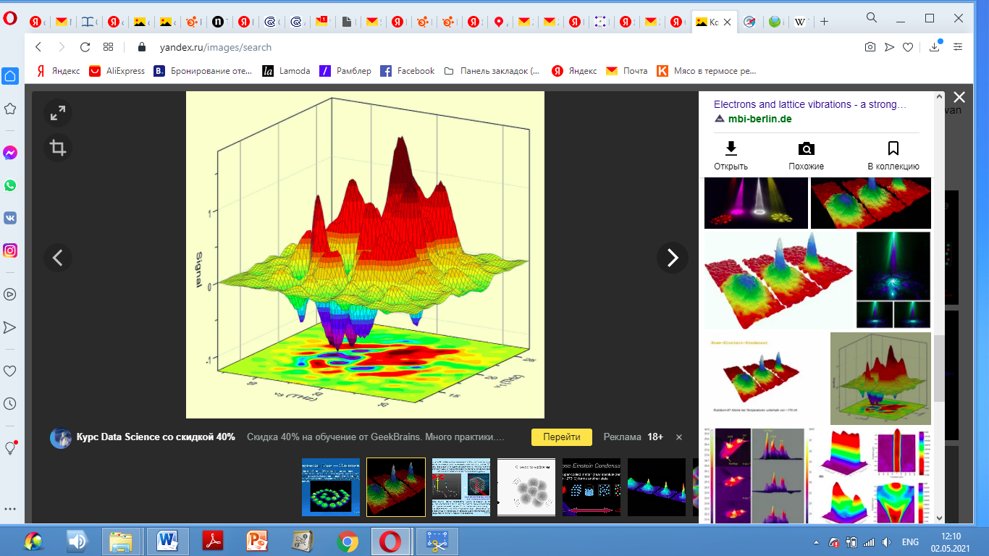
Fermi
condensate
Single theory for different force interactions and state of matter
Force field | ρ [kg/m³] | p [Pa] | n [1/m³] | D= sqrt(e₀kT /q∙n₀)
Electromagnetics T₀ = 2.735 K (non-condensed) | 10⁻²⁶ | 10⁻⁹ | 1.8∙10¹³ | 2720 km
Electroweaks Tvar (Bose-condensed) | 10² | 10²⁰ | 1.35·10⁴³ | 10⁻¹¹ m
Electro strong Tvar (Fermi-condensed) | 10⁸ | 10³⁵ | 10⁵⁷ | 10⁻¹⁷ m
Electro gravitation (the Earth) (non-condensed) | 10⁻²³ | 10⁻⁶ | 1.8∙10¹⁶ | 86 km
M.Ja. Ivanov. Space Energy. In Energy Conservation, Ed. A.Z. Ahmed, INTECH, 2012, pp. 3-56. DOI: 10-5772/52493.
Basov N.G. et al. A non-linear acceleration of a light impulse. JETP. v. 50, № 1 (1966) (in Russian).
G. F. Savelyev. Search and detection of microleptons. M. 1998.
M. Ja. Ivanov and L. V. Terentieva. Gasdynamic Elements of Dispersive Medium, 2002.
Conservation Laws in Modern Physics with Technical Applications. Ed. M.Ja. Ivanov. UK.BPI. DOI: 10.9734/bpi/mono/978-93-90516-71-1.
M.Ja. Ivanov, Ju.I. Malakhov Registration of Temperature Dependence for Electromagnetic Front Velocity with Theoretical Support. ZST. – VNIITF, 2012 – p.154.
J. C. Algaba, J. Anczarski, K. Asada et all. Broadband Multi-wavelength Properties of M87 during the 2017 Event Horizon Telescope Campaign The Astrophysical Journal Letters, 911:L11 (43pp), 2021 April 10 https://doi.org/10.3847/2041-8213/abef71.

