Slide 1



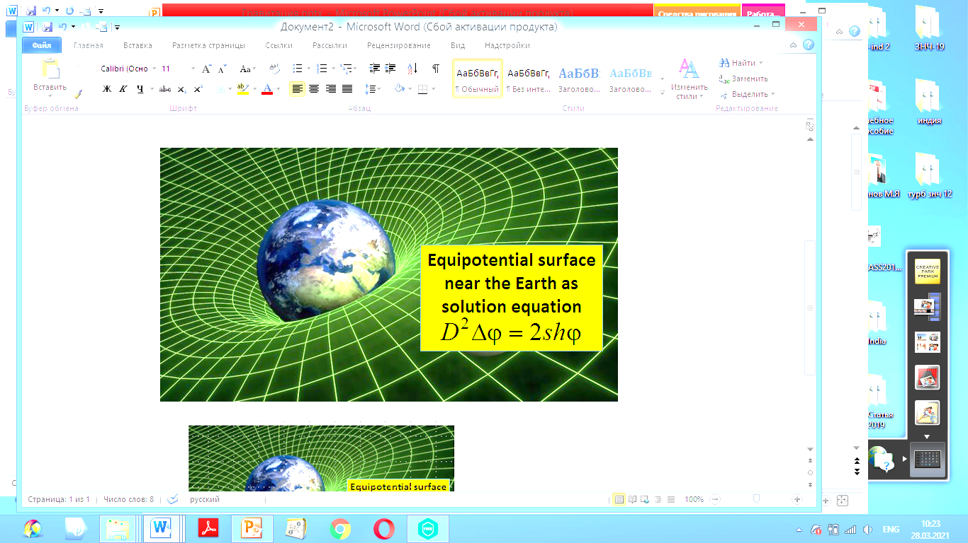
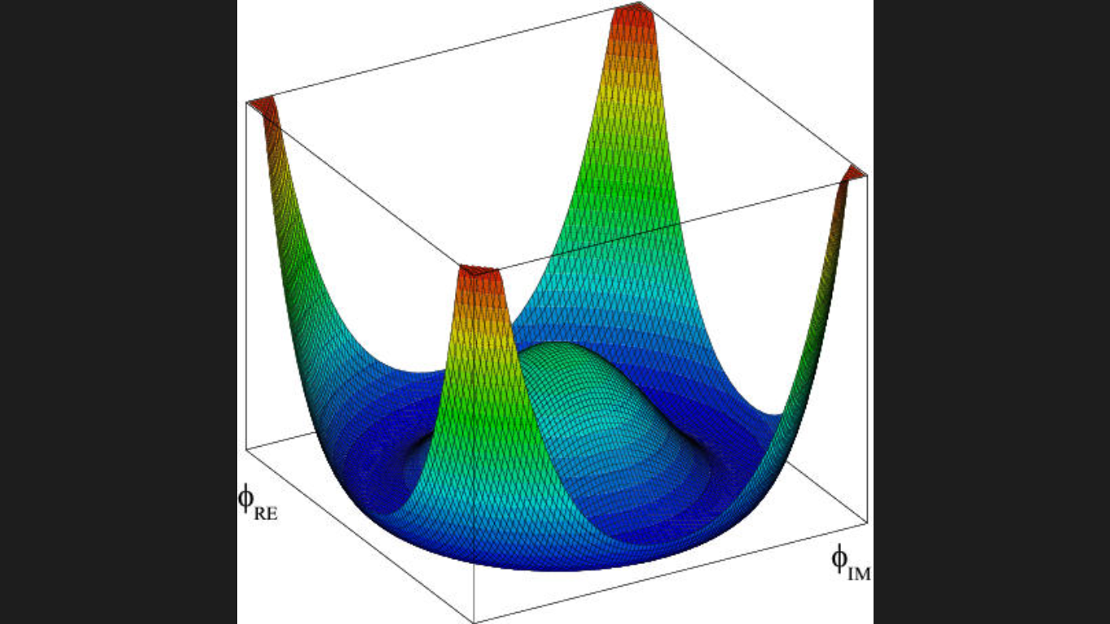
M. Ja. Ivanov, Li Jaling, Zheng Guanghua
Conservation laws in string theory of condensed matter
for modeling of electromagnetic and gravitational force fields
Potential distributions
for Newton’s field and
one component Higgs’ field
CIAM, Moscow,11 June 2021

Slide 2

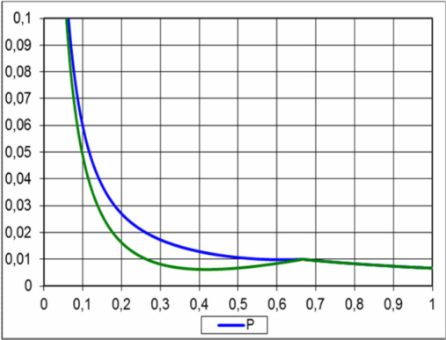
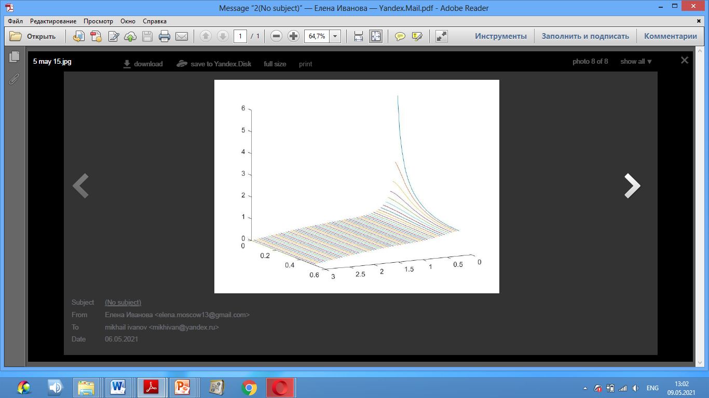
Conservation laws of condensed matter
The integral conservation laws for the volume ω(t) with the boundary γ(t)
where k = n, I and e – neutral, positive and negative medium components and q² - the square of velocity vector. The system is closing by the state equations.
For one velocity approach we obtain the summary laws as composition of these equations in the same form. The force field consist on the gradients pressure p and electric potential φ. In the steady case we obtain the system of equations
and have the main law in the same form for Newton's and Coulomb’s laws
E = mc² = hν = kT; Temperature T₀=2.735 K;
State equation p = n∙mc² = n∙kT
Hidden mass boson (classic dipole):
m ≈ 3∙10⁻⁴ eV; q = 5∙10⁻²⁹ C;
Polarized space with screening : potential distributions for spherical and cylindrical

Slide 3
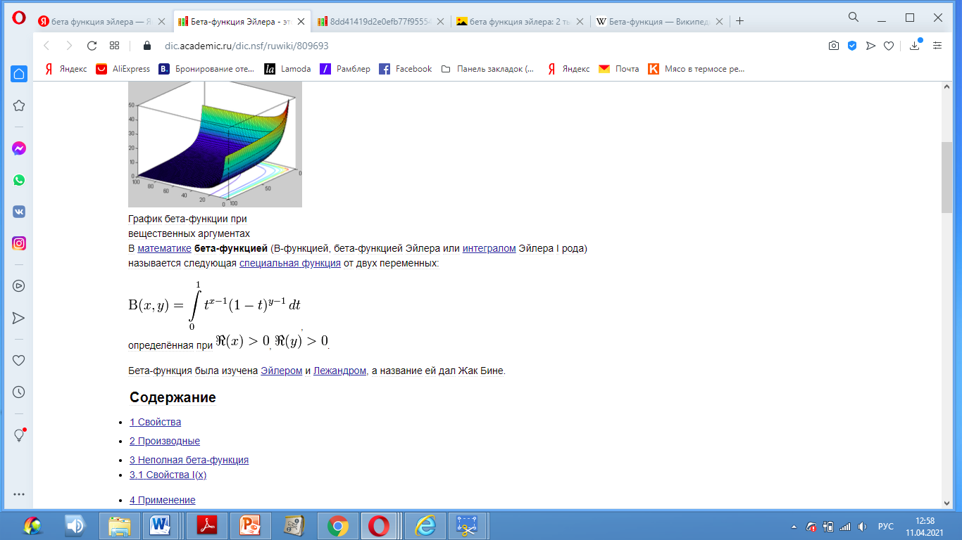
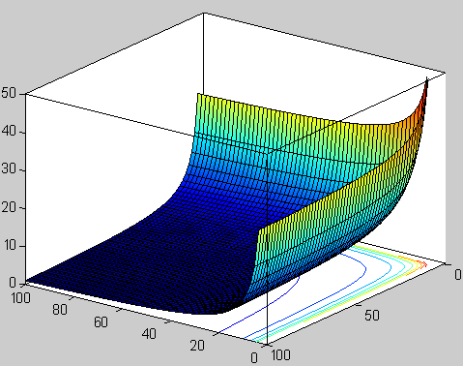
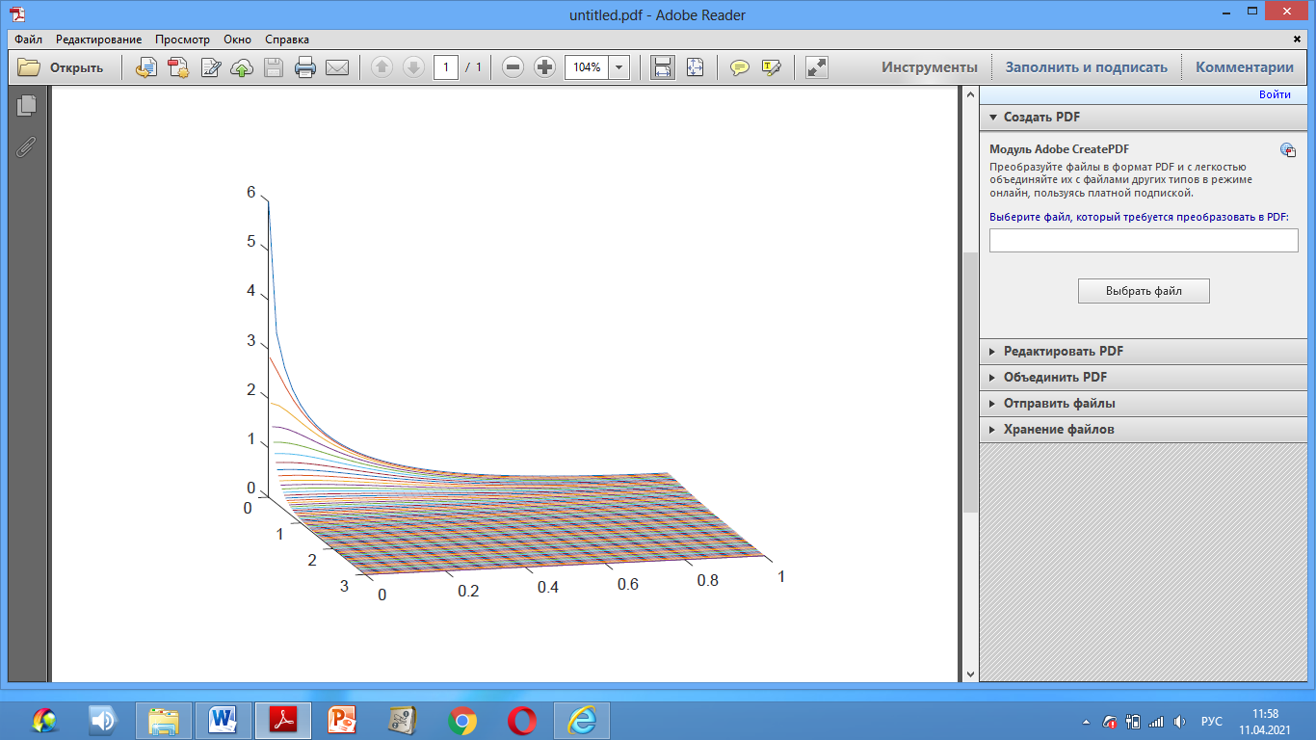
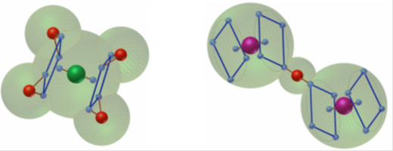
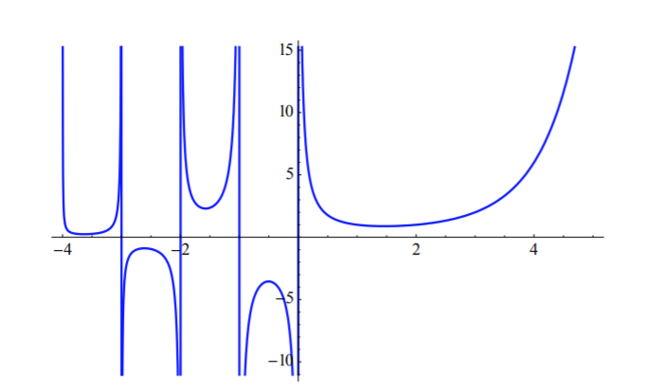
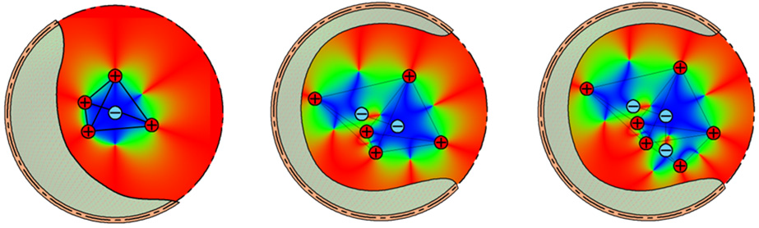

String theory of condensed matter
Euler’s function
Electron screening
layer space
Scheme of proton screening
two layer space
String field
Neuton’s field
Structures for CH4 and HF2 molecules
Internal condensed structures of Lithium 4Li, 5Li and 6Li

Slide 4

Modeling of electromagnetic and gravitational force fields
Any baryonic body has a positive small shielded
charge, which equates the laws of Newton and Coulomb
Q_{b} ~ ± sqrt (G/k)∙M
The Earth: G = 6,674∙10 ⁻¹¹ m³/kg∙c² ; k = 8,988∙10 ⁹ N∙m²/Cu²; M_{e} = 5.97×10²⁴ kg;
Gk =± sqrt (G/k) = ±0,8617 ∙10⁻¹⁰; Q_{b} = ± sqrt (G/k)∙M = 5,146∙10 ¹⁴ Cu;
The Earth swirling gives registries magnetic fields: B = 0,5 Э = 40 A/m.
String gravity is based on the fundamental difference in the structure of the polarized spaces of the proton and electron that form the neutron. The total polarized space of the neutron has an uncompensated part, which causes, firstly, the excess of the neutron mass of the total mass of the proton and electron, and, secondly, the presence of a residual charge and an electric potential of interaction for each body from baryonic matter.
The elementary particle of physical vacuum is a classical dipole with known properties, which allows these dipoles to form micro strings of various lengths. Micro strings are capable of creating local concentrations of positive or negative charge and are carriers of electromagnetic waves.
The transmission of all types of interactions is determined by a combination of force fields defined by the gradients of the electric potential and the natural pressure of the medium.
The polarization of physical vacuum under consideration provides Debye shielding of positive and negative point charges, balls, charged surfaces and capacitor plates.
            M.Ja Ivanov. Space Energy. In “Energy Conservation”, Ed. A.Z. Ahmed, INTECH, 2012,
            pp 3-56. DOI: 10-5772/52493.
Conservation Laws in Modern Physics with Technical Applications. Ed. M.Ja. Ivanov. UK.BPI. DOI: 10.9734/bpi/mono/978-93-90516-71-1.

