Slide 1
THE PRINCIPLES OF GENERATING THE VECTOR POTENTIAL OF MAGNETIC AND ELECTRIC FIELDS (VP MEF) AND FIXING THE VARIATIONS OF THE VP MEF IN REAL TIME
# EGOROV EVGENY IVANOVICH,
ASSOCIATION OF INNOVATIVE DEVELOPMENT,
Omsk-Vladivostok, Russia.
E-mail: czl4otk9omsk@gmail.com, Tel. +7 913 960 79 74.

Slide 2
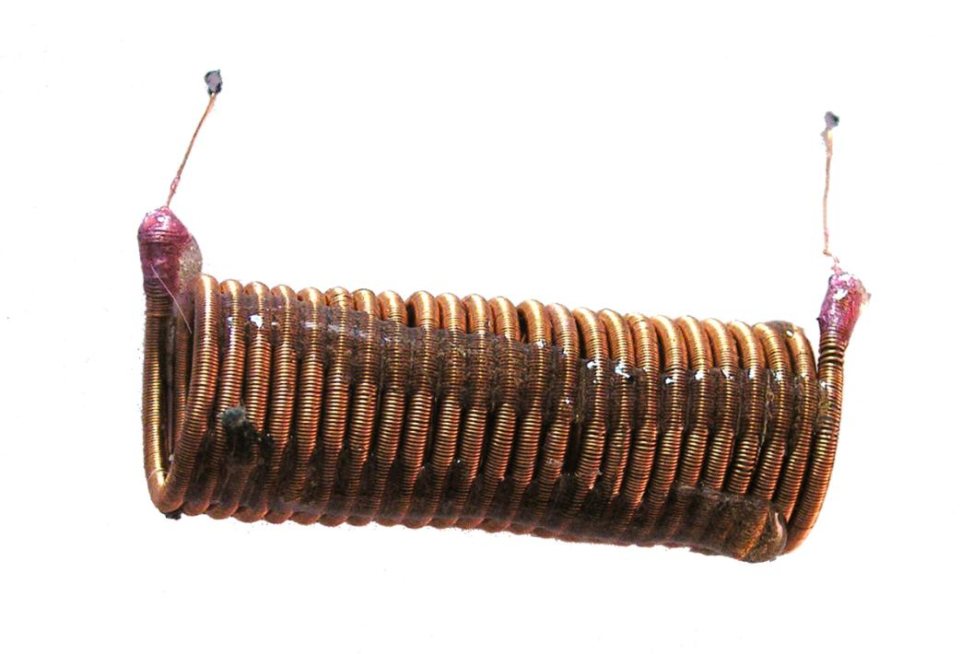
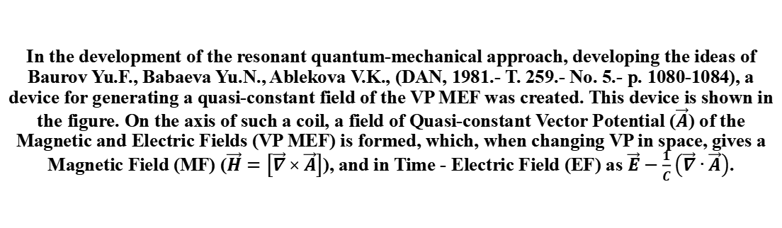
In the development of the resonant quantum-mechanical approach, developing the ideas of Baurov Yu.F., Babaeva Yu.N., Ablekova V.K., (DAN, 1981.- T. 259.- No. 5.- p. 1080-1084), a device for generating a quasi-constant field of the VP MEF was created. This device is shown in the figure. On the axis of such a coil, a field of Quasi-constant Vector Potential ($\vec{A}$) of the Magnetic and Electric Fields (VP MEF) is formed, which, when changing VP in space, gives a Magnetic Field (MF) ($\vec{H}=\left[\vec{∇}×\vec{A}\right]$), and in Time - Electric Field (EF) as $\vec{E}−\frac{1}{C}\left(\vec{∇}∙\vec{A}\right)$.

Slide 3
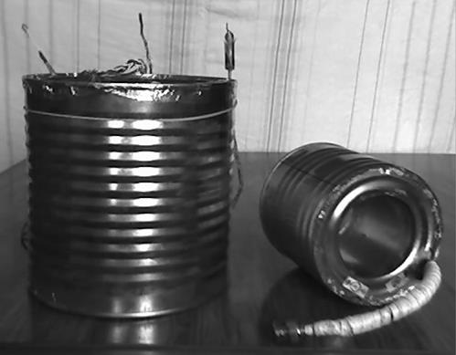
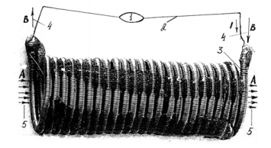
In 2010, it was shown that VP MEF formed by direct currents of ~ 0.1 A, flowing in devices with a characteristic size of ~ 0.1 m, reproducibly and reliably affect rather conservative characteristics such as the density of substances, the optical properties of a substance.
A-coil connection diagram. Arrows correspond to the directions of real physical quantities.
Tinned sheet coils

Slide 4
It is shown that the flow of theVP MEF permeates the Universe from the Megagalactic level of ~ 10 ^ 28 cM to the entities of the Planck size ~ 10 ^ -34 cM and can be described from the standpoint of classical terms and the Maxwell-Hertz-Heaviside equations, which are incomplete. For a complete description of the essence of MF and EF and their interactions and transformations in Space and Time, it is necessary to use not only complex, but also hypercomplex numbers. The Hyperbolic Analogue of the Electric and Magnetic Field by D.G. PAVLOV (GAEMP ) eryse.
This approach allows not to be limited to the spaces described by complex numbers, but also to project the phenomena of Nature onto the WHOLE PROJECTIVE PLANE, including the point ∞. It is this procedure that representatives of the Earth's Biota use in the process of representing and studying the Natural Processes surrounding them. Quasiparticles byuons are introduced. They are carriers of the VP MEF, which propagate along parallel straight lines in the sense of A.F. CHERNYAEV.These parallel lines lie on one-sided non-orientable surfaces, homeomorphic to a circle (MÖBIUS strip, 3D KLEIN bottle, 4D KLEIN surface). With the COMPLETE description of the Electromagnetic Wave forming by the VP MEF, it is necessary to introduce the BYUON-FINSLER TORO-SHAPED COMPONENT (BFTC) of the Electromagnetic Wave (EMW). This EMW element eliminates the problem of the giant dispersion of Maxwellian electromagnetic waves in the Physical Vacuum (PV). The full electromagnetic wave propagating in the PV looks like this:

Slide 5
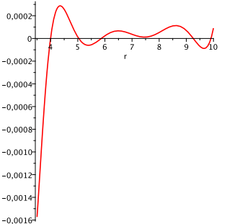
In the energetic Finsler Space with the Berwald-Moor metric, a set of minima arises in which structures can be formed, the elements of which are connected by GAEMP described by functions in hyperbolic variables, which are regions in which entities such as microlepton formations, neutrinos, and so on are formed, occupying intermediate Spaces between hadronic objects and atomic structures

Slide 6
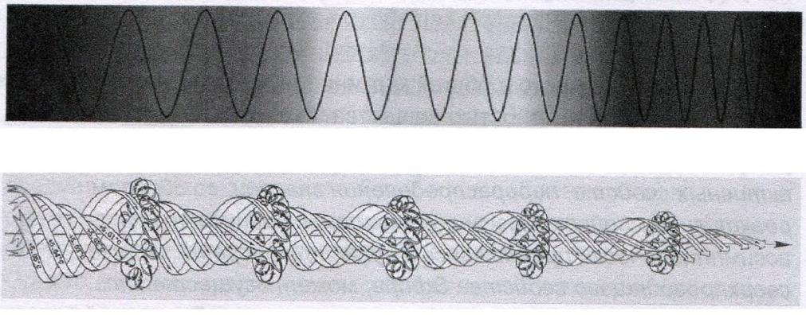
A type of EMW, including BFTC, which is not absorbed by conductive media because it contains a closed magnetic field capable of accumulating and storing cyclopean energies. In the figure, the generators are the flows of the VP MEF

Slide 7
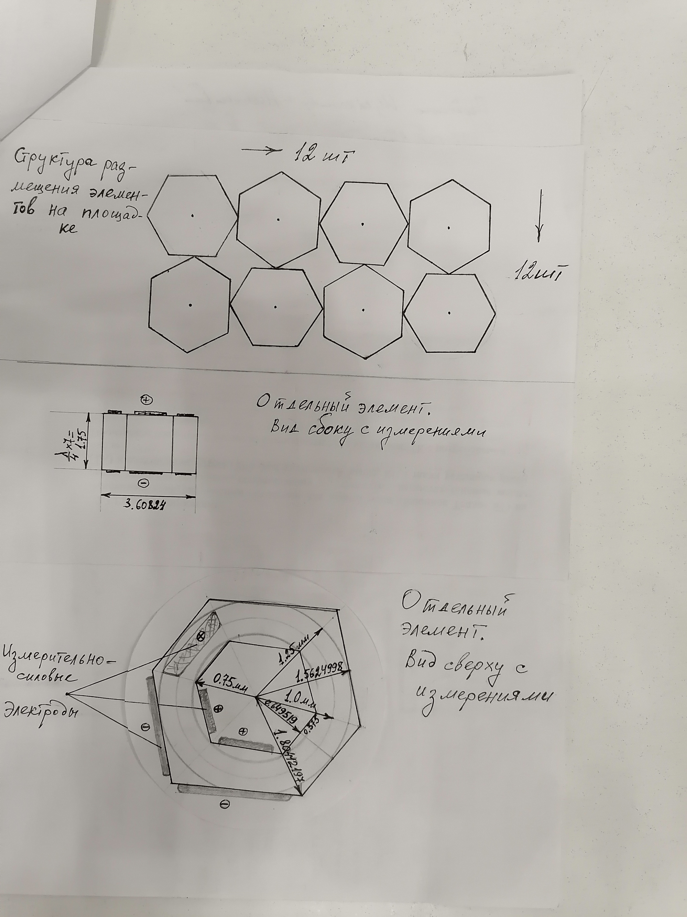
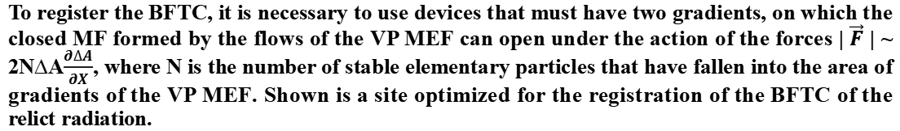
To register the BFTC, it is necessary to use devices that must have two gradients, on which the closed MF formed by the flows of the VP MEF can open under the action of the forces | $\vec{F}$ | ~ 2N∆A$\frac{∂∆A}{∂X}$, where N is the number of stable elementary particles that have fallen into the area of gradients of the VP MEF. Shown is a site optimized for the registration of the BFTC of the relict radiation.

Slide 8
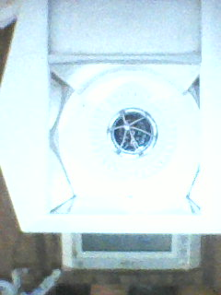
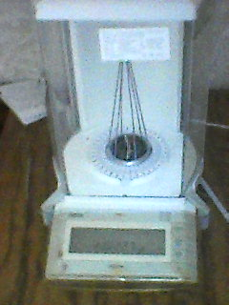
The final flow of the VP MEF consists of the Galactic flow of the VP, the Solar flow of the VP, the flow generated by the Earth's magnetic dynamo and the local generators of the VP MEF. Registration in real time leads to high-precision recording of the weight of the compass, as an object containing an element that accumulates MF, possibly supplemented by an asymmetric tortion balance a suspension. This shown in the figure.

Slide 9
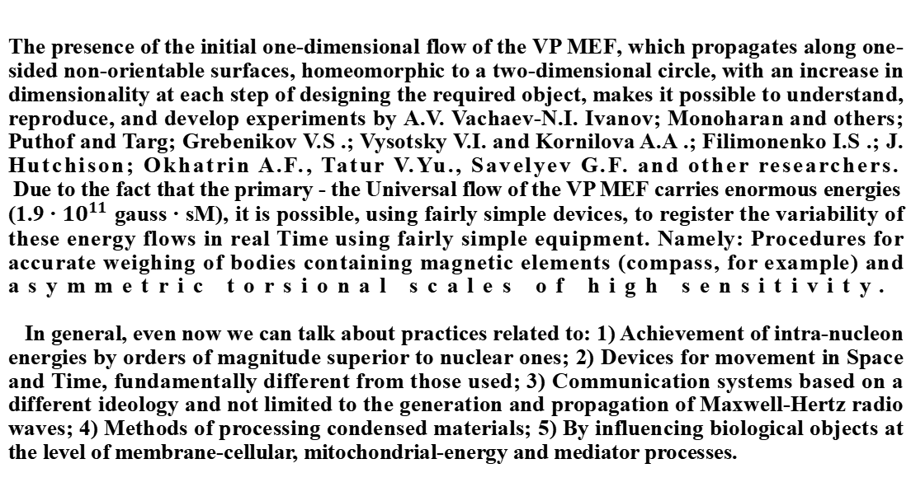
The presence of the initial one-dimensional flow of the VP MEF, which propagates along one-sided non-orientable surfaces, homeomorphic to a two-dimensional circle, with an increase in dimensionality at each step of designing the required object, makes it possible to understand, reproduce, and develop experiments by A.V. Vachaev-N.I. Ivanov; Monoharan and others; Puthof and Targ; Grebenikov V.S .; Vysotsky V.I. and Kornilova A.A .; Filimonenko I.S .; J. Hutchison; Okhatrin A.F., Tatur V.Yu., Savelyev G.F. and other researchers.
Due to the fact that the primary - the Universal flow of the VP MEF carries enormous energies (1.9 ∙ ${10}^{11}$ gauss ∙ sM), it is possible, using fairly simple devices, to register the variability of these energy flows in real Time using fairly simple equipment. Namely: Procedures for accurate weighing of bodies containing magnetic elements (compass, for example) and asymmetric torsional scales of high sensitivity.
In general, even now we can talk about practices related to: 1) Achievement of intra-nucleon energies by orders of magnitude superior to nuclear ones; 2) Devices for movement in Space and Time, fundamentally different from those used; 3) Communication systems based on a different ideology and not limited to the generation and propagation of Maxwell-Hertz radio waves; 4) Methods of processing condensed materials; 5) By influencing biological objects at the level of membrane-cellular, mitochondrial-energy and mediator processes.

Slide 10
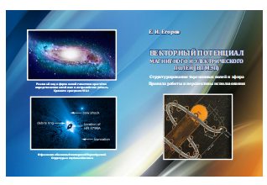
The most complete presentation and substantiation of the New Paradigm of Natural Science, which is based on the construction of Natural objects of real Nature from the Vectorial Potential of the Magnetic and Electric Fields, is in the following monograph:

Slide 11
Thanks for attention !

