Slide 1
Poster 1
A Theory of Light Element Nuclear Reaction
#William H. McCarthy, PhD
¹ Retired, Materials Engineer
E-mail: santander@earthlink.net
Many experiments have shown anomalous heat and/or helium from hydrogen (light or heavy isotopes). Electrolytic, thermal, plasma, acoustic and other methods have been used. These observations, conventionally known as Low Energy Nuclear Reactions, were extensively documented by Edmond Storms [1] (especially Table 2, pages 53 to 61 therein) and by several others. All of the reactants and nuclear products involved in these reactions are stable and no neutrons or other dangerous emanations are involved.
[1] Edmund Storms, The Science of Low Energy Nuclear Reaction (A Comprehensive Compilation of Evidence and Explanations about Cold Fusion), 1^{-st} edition, World Scientific Publishing Co., 27 Warren St, Suite 401, Hakensack NJ 07601, 2002.

Slide 2
Poster 2
Experiments by this author [2], [3] using dry reactions of light hydrogen and boron in copper show statisticaly more heat output than electrical input. An exanple is given in Poster #3. A control without hydrogen, Poster #4, produced no excess heat.
It is suggested that the LENR reaction involves combination of either stable isotope of hydrogen with light elements, rather than hydrogen only or hydrogen with the matrix metals. Lithium is an obvious reactant in tests using LiOH electrolyfes. Boron is a common deoxider used in the production of platinum and other matrix metals exhibiting the effect. Some charged-particle motion also seems necessary to get the reactant ions to occasionally combine. That may be provided in the classic Pons-Fleischmann experiments by the deuterium bubble screen on the surface of the cathode. In the tests of posters #3 and 4, that chaos was accomplished by an “insulator” layer between the electrodes containing graphite particles in oil.
A frustrating characteristic of this phenomenon is its inconsistency: some researchers have never produced the effect, others observe heat or helium in most trials, few (if any) can always predict the result. The inconsistancy may be explained by the mosstly unrecognized requirements alluded to in the previous paragraph.
[2] Wm. H. McCarthy, "Water-Free Replication of Pons-Fleischmann LENR", J. Condensed Matter Nucl. Sci., Vol. 15, pp. 256–267, (2015)
[3] Wm. H. McCarthy, "Light Hydrogen LENR in Copper Alloys", ,J. Condensed Matter Nucl. Sci. , Vol 29, pp. 191–201, (2019)

Slide 3
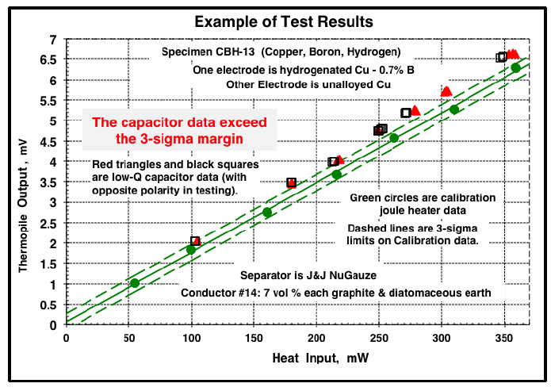
Poster 3

Slide 4
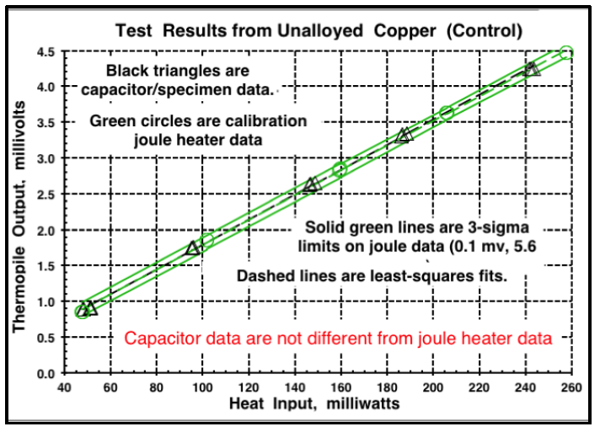
Poster 4

Slide 5
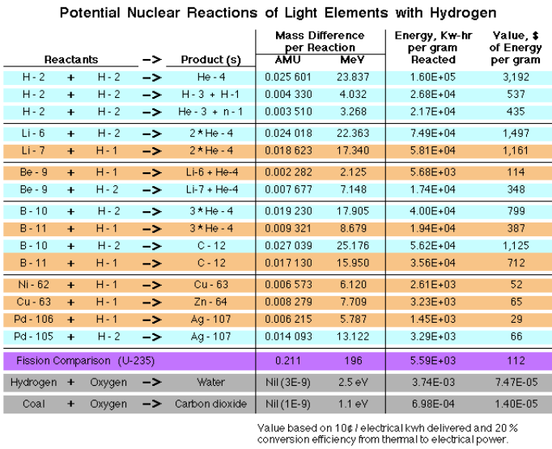
Poster 5

Slide 6
Poster 6
Poster 5 is a table of the energies calcaulated from the mass balances of variouc reactions that might be involved in LENR. Blue shaded rows are reactions with deuterium, orange indicates light hydrogen. At the bottom are compasisons for fusion and combustion.
Note that the reactions involving lithium and boron substantially exceed the less then 30 Kw/gm output of the weapon energies of the 2nd and 3rd rows in the table. Thus, it appears that “Low Energy” in LENR is not appopriate; It would be better to sbstitute “Light Element”.
The tremendois potential of LENR to solve energy and climate problems is obvious from Poster 5, however the acronym is expanded.

